Slide 1
Hotel booking analysis
CAPSTONE PROJECT
Presented By:
A NAVEEN CLITON (AUT2291240008)
9124,SHANMUGANATHAN ENGINEERING COLLEGE, ARASAMPATTI
MECHANICAL ENGINEERING

Slide 2
OUTLINE
Problem Statement
Proposed System/Solution
System Development Approach
Algorithm & Deployment
Result
Conclusion
Future Scope
References

Slide 3
Problem Statement
Have you ever wondered when the best time of year to book a hotel room is? Or the optimal length of stay in order to get the best daily rate? What if you wanted to predict whether or not a hotel was likely to receive a disproportionately high number of special requests? This hotel booking dataset can help you explore those questions! This data set contains booking information for a city hotel and a resort hotel, and includes information such as when the booking was made, length of stay, the number of adults, children, and/or babies, and the number of available parking spaces, among other things. All personally identifying information has been removed from the data. Explore and analyse the data to discover important factors that govern the bookings.

Slide 4
Proposed Solution
The proposed solution of this program involves leveraging the insights derived from the analysis to optimize various aspects of hotel management. Firstly, the understanding of booking trends and customer behavior can inform pricing strategies, allowing hotels to adjust rates based on demand fluctuations and maximize revenue. Secondly, insights into guest preferences and special requests can guide personalized marketing efforts and service offerings, enhancing customer satisfaction and loyalty. Additionally, by identifying patterns of cancellations or no-shows, hotels can implement proactive measures to minimize revenue loss, such as overbooking management or targeted communication with guests. Furthermore, the program's predictive capabilities can support capacity planning and resource allocation, ensuring optimal staffing levels and inventory management. Overall, the proposed solution aims to empower hotels to make data-driven decisions that enhance operational efficiency, revenue generation, and guest satisfaction.

Slide 5
System Approach
Google colab
Github

Slide 6
Algorithm & Deployment
Algorithm :The program uses a Random Forest Classifier for predicting the total number of special requests. Random Forest is a popular algorithm for classification tasks, especially when dealing with tabular data like this.
Deployment: The program demonstrates the steps leading up to model training and evaluation. For deployment, you would typically save the trained model using joblib or pickle, and then deploy it in a production environment. Deployment could involve creating APIs, web applications, or integrating the model into existing systems where it can make predictions on new data.

Slide 7
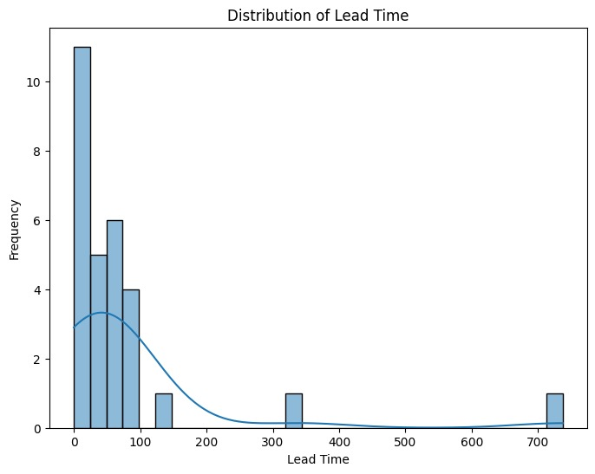
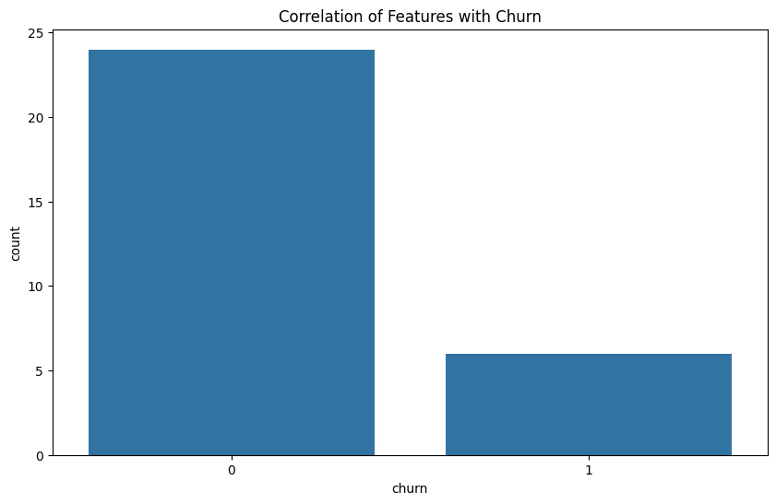
Result

Slide 8
Conclusion
The provided Python script offers a comprehensive approach to analyzing a hotel booking dataset. Through exploratory data analysis, the script sheds light on key attributes such as lead time, guest counts, and booking trends. Visualizations like the histogram of lead time provide insights into the distribution of booking durations, aiding in understanding customer behavior and preferences.
Moving forward, the script presents a machine learning model, Random Forest Classifier, to predict the total number of special requests based on various booking attributes. While the model's accuracy is evaluated, further analysis could involve exploring feature importance to discern which factors significantly influence special requests. Additionally, interpreting the model's predictions in the context of hotel operations and customer satisfaction could provide actionable insights for optimizing services and enhancing guest experiences. Overall, the script lays a solid foundation for understanding and leveraging data-driven approaches to improve hotel management and customer satisfaction.

Slide 9
Future scope
The feature scope of the Hotel Booking Analysis includes exploratory data analysis (EDA) to uncover booking patterns and trends, data visualization for intuitive representation of insights, feature engineering to enhance predictive modeling, machine learning modeling to forecast outcomes such as booking cancellations or special requests, and interpretation of results to drive actionable recommendations for hotel management.

Slide 10
References
This reference provides access to datasets related to hotel booking demand, which can be used for various analyses including exploratory data analysis, predictive modeling, and trend identification in the hotel industry. It serves as a valuable resource for researchers, data analysts, and practitioners interested in understanding hotel booking patterns and customer behavior.

Slide 11
THANK YOU

